Slide 1
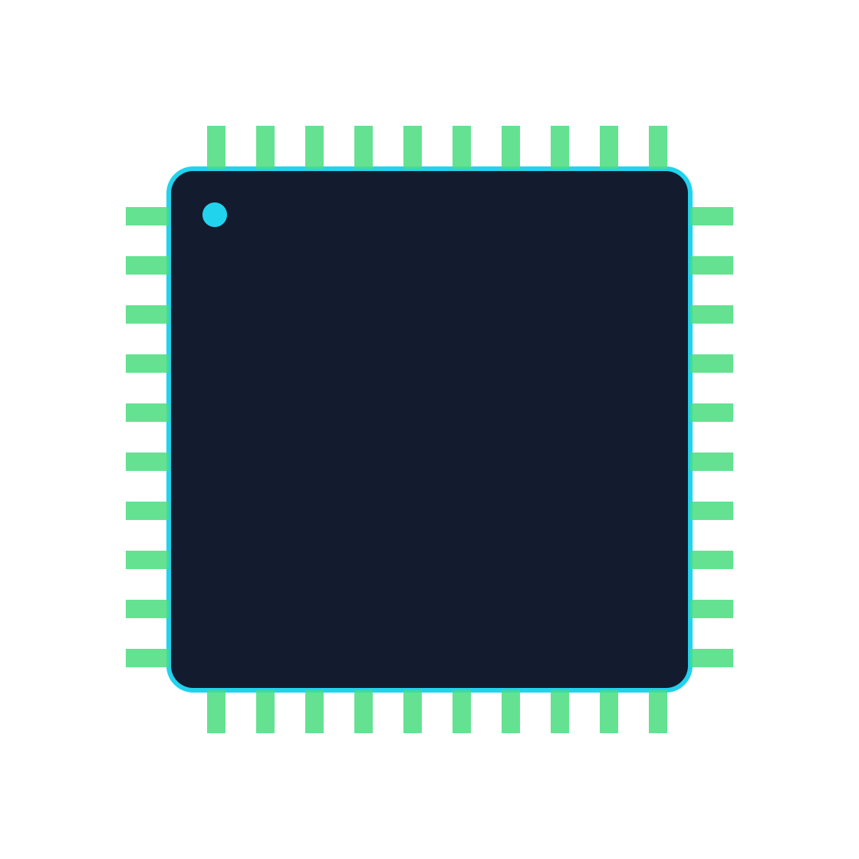
Smart Parking Assist
HACKATHON FINAL REVIEW · EMBEDDED SYSTEMS
ATmega2560
ATmega2560-based smart parking system using bare-metal drivers
16 MHz · 8-bit AVR
Objective: detect parking-slot occupancy with ultrasonic and IR sensors using register-level C drivers, and show the status on a seven-segment display, LEDs and a buzzer.
Notes:
Good morning, judges. Our project is Smart Parking Assist. It runs on the ATmega2560 chip, which is the brain of the Arduino Mega 2560 board. The goal is simple: find out if a parking slot is free or occupied, and tell the driver using a display, LEDs and a buzzer. The special part is how we built it. We did not use Arduino library functions. We wrote our own drivers that talk straight to the chip registers. This is called bare-metal programming. Please replace the bracketed placeholders with our names, college, department and hackathon name before presenting.

Slide 2

From Slot Sensor to Driver Display
02 · PROBLEM AND ARCHITECTURE
The problem
Our solution
Drivers circle the lot looking for a free slot. That wastes time and fuel, and manual checking does not scale.
Sensors detect occupancy. Bare-metal C drivers read them and show the slot status on a display, LEDs and a buzzer.
SENSORS
BARE-METAL DRIVERS
APPLICATION LOGIC
OUTPUTS
HC-SR04 ultrasonic
IR sensor (ADC / digital)
gpio · timer · pwm
ultra · adc · display
Thresholds → parking state
FREE / OCCUPIED
7-segment display
LEDs · buzzer
Arduino Mega 2560 · ATmega2560 @ 16 MHz
CORE (per project brief): GPIO · Timer · PWM · Ultrasonic · ADC · Display. Verify each against the source.
PROPOSED: sensor filtering · non-blocking display refresh · multi-slot parking.
Smart Parking Assist · ATmega2560 bare-metal drivers · 2 / 10
Notes:
Cars waste time and fuel searching for a free slot. Our solution reads sensors and shows the result clearly. Follow the block diagram from left to right. Sensors are the HC-SR04 ultrasonic sensor and an IR sensor. Their signals go into our bare-metal drivers: gpio, timer, pwm, ultra, adc and display. The application logic compares readings with thresholds and decides the parking state. Then the outputs show it: seven-segment display, LEDs and a buzzer. Everything runs on the ATmega2560 at 16 MHz. The green box lists core features from our brief, and we must confirm each one against our source code. The amber box lists proposed future features, so we do not claim them as finished.

Slide 3
GPIO Driver: Register-Level Control
03 · GPIO.C / GPIO.H
ILLUSTRATIVE · verify vs gpio.c
Register | Role | Bit meaning
DDRx | Direction | 1 = output, 0 = input
PORTx | Output level | 1 = HIGH, 0 = LOW
PINx | Input level | bit = pin state
// ILLUSTRATIVE
void gpio_mode(volatile uint8_t *ddr,
uint8_t pin, uint8_t out) {
if (out) *ddr |= (1 << pin);
else *ddr &= ~(1 << pin);
}
uint8_t gpio_read(volatile uint8_t *pinr,
uint8_t pin) {
return (*pinr >> pin) & 1;
}
Why a reusable driver?
Bit-twiddling lives in one tested place
App code reads clearly: gpio_write(LED, 1)
Change a pin once, not in 20 places
Reused by ultra, display, LED and buzzer
|= (1 << pin) sets one bit, the rest stay untouched
&= ~(1 << pin) clears one bit (the mask)
volatile forces a real register access every time
gpio_write() repeats the same pattern on PORTx
Smart Parking Assist · ATmega2560 bare-metal drivers · 3 / 10
Notes:
This is our GPIO driver. Every pin on the ATmega2560 is controlled by three registers. DDRx decides direction: 1 means output and 0 means input. PORTx sets the output level, HIGH or LOW. PINx lets us read the real pin level. In the code, the shift operator creates a mask with a single bit set. The OR operator sets that bit and the AND with an inverted mask clears it, so other pins are never disturbed. The word volatile tells the compiler the register can change by itself, so it must always read it. We made a reusable driver so that this tricky bit code exists in one tested place. Other drivers, like ultrasonic and display, call it. The code shown is an example. Before presenting, check that the function names match our gpio.h file.

Slide 4
Timer Driver: CTC and a 1 ms Tick
04 · TIMER.C / TIMER.H
EXAMPLE · confirm vs timer.c
Register | Purpose
TCCR1B | WGM12 = CTC mode · CS11, CS10 = ÷64
OCR1A | Compare value (249)
TCNT1 | 16-bit counter, clears at match
TIFR1 | OCF1A flag set at compare match
TIMSK1 | OCIE1A = interrupt enable
If CPU = 16 MHz, prescaler = 64, OCR1A = 249
f_timer = 16 MHz / 64 = 250 kHz
1 tick = 1 / 250 kHz = 4 µs
T = (249 + 1) / 250,000 = 1 ms
Hardware timer
Software delay
TCCR1A = 0;
TCCR1B = (1<<WGM12) | (1<<CS11) | (1<<CS10);
OCR1A = 249;
TIMSK1 = (1<<OCIE1A);
Counts in silicon. The CPU stays free for other work.
_delay_ms() busy-waits and blocks everything else.
Polling: loop until OCF1A = 1, then clear it by writing 1.
Interrupt: ISR(TIMER1_COMPA_vect) runs on every match.
Mode used in our code: [confirm in timer.c]
Smart Parking Assist · ATmega2560 bare-metal drivers · 4 / 10
Notes:
Our timer driver uses Timer1 in CTC mode. CTC means Clear Timer on Compare match. The counter TCNT1 counts up, and when it reaches the value in OCR1A, hardware sets a flag and restarts from zero. The prescaler divides the 16 MHz clock by 64, so the timer runs at 250 kHz. One tick is 4 microseconds. With OCR1A equal to 249 we count 250 ticks, which is exactly 1 millisecond. A hardware timer is better than a software delay because the CPU is free to do other jobs. We can either poll the flag or use an interrupt. Important: these numbers are the standard example. Check timer.c, and if our real values differ, update this slide before presenting.

Slide 5
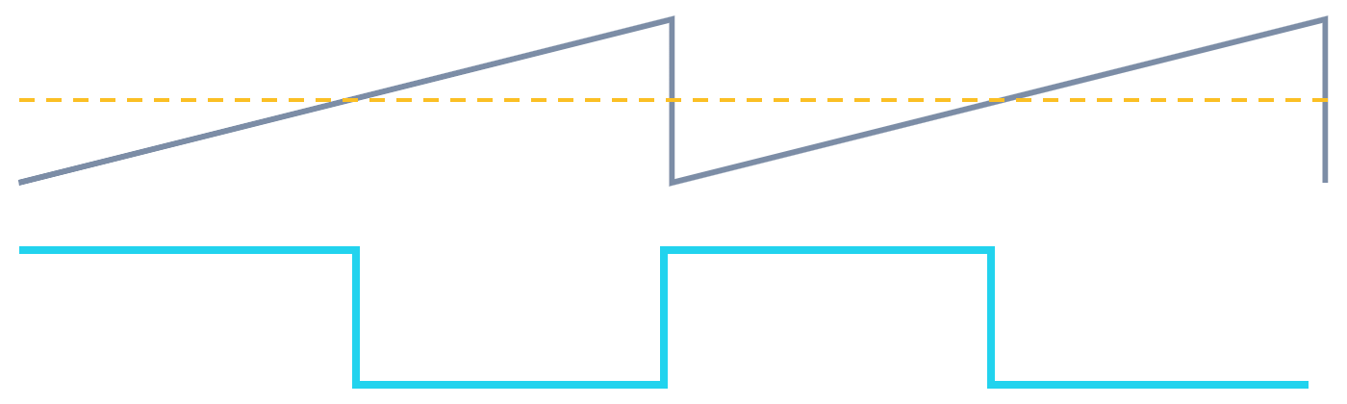
PWM: Fast PWM on Timer3
05 · PWM DRIVER
ILLUSTRATIVE · verify vs pwm.c
Register | Bits set | Role
TCCR3A | COM3A1, WGM30 | Non-inverting · mode
TCCR3B | WGM32, CS31, CS30 | Fast PWM · ÷64
DDRE | PE3 | OC3A pin = output
OCR3A | 128 | Duty (compare value)
f_PWM = f_clk / (N × 256)
= 16,000,000 / (64 × 256)
≈ 976.56 Hz
Duty ≈ 128 / 255 ≈ 50.2 %
exact: (128 + 1) / 256 = 50.4 %
TCCR3A = (1<<COM3A1) | (1<<WGM30);
TCCR3B = (1<<WGM32) | (1<<CS31) | (1<<CS30);
DDRE |= (1<<PE3); // OC3A = D5
OCR3A = 128; // ~50 % duty
Fast PWM: one slope, f = f_clk / (N × 256) ≈ 976.56 Hz.
Grey: TCNT3 counts 0 to 255. Dashed: OCR3A. Cyan: OC3A output, HIGH until the match.
Phase Correct: two slopes, f = f_clk / (N × 510) ≈ 490.2 Hz.
Smart Parking Assist · ATmega2560 bare-metal drivers · 5 / 10
Notes:
PWM means Pulse Width Modulation. We switch a pin on and off very fast, and the duty cycle, the percentage of time it is HIGH, controls the average power. We use Timer3 in 8-bit Fast PWM mode with prescaler 64. The output is OC3A on pin PE3, which is Arduino Mega pin D5. Frequency is 16 million divided by 64 times 256, which is about 976.56 hertz. With OCR3A equal to 128, duty is about 50 percent. A quick formula gives 50.2 percent. The exact hardware value is 129 out of 256, which is 50.4 percent. Both are fine to mention. The hardware does the work: the counter runs 0 to 255, the pin goes HIGH at zero, and goes LOW when the counter matches OCR3A. The CPU does nothing for each cycle. Phase Correct mode counts up and down, so it is slower, about 490 hertz. Important: these settings are not confirmed until we check pwm.c.

Slide 6



Ultrasonic Driver: Echo Time to Distance
06 · ULTRA.C / ULTRA.H
ILLUSTRATIVE · verify vs ultra.c
ATmega2560
HC-SR04
Distance = (t × v) / 2
5 V
VCC
v ≈ 343 m/s = 0.0343 cm/µs
[TRIG pin] out
TRIG
d (cm) ≈ t (µs) / 58
[ECHO pin] in
ECHO
e.g. t = 1160 µs → about 20 cm
GND
GND
// ILLUSTRATIVE
trigger_pulse(); // 10 us HIGH
t_us = echo_high_time(TIMEOUT);
return t_us / 58; // cm, 0 = timeout
TRIG HIGH for at least 10 µs
Sensor sends 8 bursts at 40 kHz
ECHO stays HIGH for the round trip
Driver times ECHO, with a timeout
Common causes of a zero reading
No echo: object outside 2–400 cm, or soft / angled
TRIG and ECHO swapped, or 5 V / GND missing
TRIG pulse shorter than 10 µs
Timeout too short, or wrong timer prescaler
Smart Parking Assist · ATmega2560 bare-metal drivers · 6 / 10
Notes:
The HC-SR04 measures distance with sound. We set the TRIG pin HIGH for at least 10 microseconds. The sensor sends eight bursts of 40 kilohertz sound. Then the ECHO pin goes HIGH and stays HIGH until the sound comes back. Our driver measures how long ECHO stays HIGH. Sound travels about 343 metres per second, and the sound goes to the object and back, so we divide by 2. This gives distance in centimetres is roughly time in microseconds divided by 58. For example, 1160 microseconds is about 20 centimetres. We add a timeout so the program never waits forever if there is no echo. If the reading is zero, check the common causes in the amber box: no echo, swapped wires, short trigger pulse or bad timeout. The pin names in brackets must be filled from our ultra.h file.

Slide 7
ADC, IR Sensor and Parking Logic
07 · ADC AND IR SENSOR
ILLUSTRATIVE · verify vs adc.c
Register | What we set
ADMUX | REFS0 = 1 (AVcc reference) · MUX = channel
ADCSRA | ADEN on · ADSC starts · ADPS = 111 (÷128, 125 kHz)
ADC | 10-bit result, 0 to 1023 (ADCL / ADCH)
Aspect | Digital IR | Analog IR
Output | 0 or 1 | 0–5 V level
Read by | gpio_read() | ADC driver
Gives | Present / absent | Level to compare
ADMUX = (1<<REFS0) | (ch & 7);
ADCSRA = (1<<ADEN) | (1<<ADPS2)
| (1<<ADPS1) | (1<<ADPS0);
ADCSRA |= (1<<ADSC); // start
while (ADCSRA & (1<<ADSC)); // wait
return ADC; // 0..1023
state = (reading vs [THRESHOLD])
? [OCCUPIED] : [FREE];
Use the real threshold and state names from the source only.
ADC = 512 → 512 / 1024 × 5 V = 2.5 V
A voltage level, not centimetres. IR output depends on surface and light, so it only supports threshold decisions.
Smart Parking Assist · ATmega2560 bare-metal drivers · 7 / 10
Notes:
The ADC, or Analog to Digital Converter, turns a voltage into a number. Ours is 10-bit, so it gives 1024 levels from 0 to 1023. With a 5 volt reference, each step is about 4.9 millivolts. We set the reference in ADMUX and choose the channel. In ADCSRA we enable the ADC, choose a prescaler of 128 so the ADC clock is 125 kilohertz, and start a conversion by setting ADSC. When the hardware clears that bit, the result is ready in the ADC register. A digital IR sensor gives only 0 or 1. An analog IR sensor gives a voltage level, which we compare with a threshold to decide the parking state. An ADC value of 512 is about 2.5 volts. It is not 512 centimetres and not a distance, because IR output changes with surface and light. Fill the threshold and state names only from our real source code. Note: channels 8 to 15 on the Mega also need the MUX5 bit.

Slide 8

Seven-Segment Display and Indicators
08 · DISPLAY, LED AND BUZZER
ILLUSTRATIVE · verify vs source
Type | Common cathode | Common anode
Common pin | GND | +5 V
Segment ON | drive HIGH | drive LOW
Digit 0 | 0x3F | 0xC0
Segments a–g are shared. Digit-select lines pick one digit at a time.
Lookup table, common cathode, bits gfedcba
0:3F 1:06 2:5B 3:4F 4:66
5:6D 6:7D 7:07 8:7F 9:6F
Sensor to output
Sensor reading
Distance or parking state
Split into tens and ones
Lookup table gives segment pattern
Multiplex both digits on PORT pins
State drives LEDs and buzzer
Multiplexing and flicker
Digits off, load segments, enable one digit
Wait about 2–5 ms, then swap digits (≈100 Hz)
Long blocking delays elsewhere cause flicker
LED via gpio_write(); buzzer via GPIO or PWM (D5)
Smart Parking Assist · ATmega2560 bare-metal drivers · 8 / 10
Notes:
A seven-segment digit has seven LEDs, called a to g. A lookup table stores which segments to light for each number. For a common cathode display, a 1 turns a segment on, so zero is 0x3F. For a common anode display it is the opposite, so zero is 0xC0. To use two digits with few pins, we multiplex. All segment lines are shared, and we switch digit-select lines. We light digit one for a few milliseconds, then digit two, again and again. Our eyes see both digits lit. If other code blocks for too long, the refresh slows and the display flickers. The data flow is on the left: sensor reading, distance or state, split into tens and ones, table lookup, then output on the port pins. LEDs use gpio_write. The buzzer may use GPIO or the PWM output on D5. Please confirm which display type and buzzer method our hardware really uses before presenting.

Slide 9
What We Built and Learned
10 · CONCLUSION, FUTURE SCOPE AND VIVA
Bare-metal drivers
Direct register control
Timer and PWM maths
Sensor integration
Modular C, .c and .h
Datasheet-first debugging
FUTURE SCOPE
Sensor filtering (median / average)
Non-blocking display refresh (ISR)
Multi-slot parking, more sensors
VIVA Q&A
Why write registers directly?
What does DDRx do?
Full control, smaller code, no hidden delays.
Sets each pin: 1 = output, 0 = input.
How do we get 1 ms?
Is ADC 512 in centimetres?
16 MHz ÷ 64 = 250 kHz; 250 ticks = 1 ms.
No. It is a voltage level, about 2.5 V.
Smart Parking Assist · ATmega2560 bare-metal drivers · 10 / 10
Notes:
To conclude: we built Smart Parking Assist using bare-metal drivers on the ATmega2560. We controlled hardware by writing registers directly, we calculated timer and PWM settings from the clock and prescaler, we connected ultrasonic and IR sensors, and we organised the code into small reusable .c and .h modules. Our key lesson was to read the datasheet first and check every register bit. For the future, we can filter noisy sensor readings, refresh the display from a timer interrupt so it never blocks, and extend the system to many parking slots. Now we are ready for viva. Four likely questions are on the slide: why use registers, what DDRx does, how we make 1 millisecond, and why ADC 512 is not centimetres. Before presenting, make sure the numbers match our real source code.

